Slide 1
STRIVE 2024
What does being emotionally well mean today?
What is self-advocacy and what do our children need to learn to do?
Love Language
Step by Step as a Parent
Resources
Q and A
Amber Raymond & Lynn McLaughlin 2024
Notes:
Agenda for the evening

Slide 2
What Does Being Emotionally Well Mean?
We know ourselves
Likes and dislikes
Strengths
How and when we experience different emotions
We know how to control ourselves
How to reflect before reacting
Different coping strategies that work for us
When we need a break from others
Amber Raymond & Lynn McLaughlin 2024
Notes:
Amber to do Research to support how successful and healthy people are when they have emotional intelligence

Slide 3
We know how to communicate with others
How to distinguish between our heart and our fear
How to respectfully share our thoughts and feelings
How to speak to ourselves with respect
We know how to set goals and work towards them
That everyone has different skill sets/gifts
Learning ways to use our gifts

Slide 4
What is Self-Advocacy?
…When we take action on our own behalf.
Successful adults with learning disabilities have identified the ability to
self advocate as an important factor contributing to success.
“Students with learning disabilities who are supported to develop these skills are more likely to be proactive, take charge of their life at school, persevere in the face of obstacles, and learn from their mistakes.”
(LD@School)
Amber Raymond & Lynn McLaughlin 2024
Notes:
Amber to explain each one more fully

Slide 5
Students should:
Know and understand their Learning Disability
How they learn
What are their strengths and needs?)
Be involved in the creation of the IEP and understand the accommodations/modifications they are entitled to
Learn to use the vocabulary of self advocacy
Be involved in setting goals
Amber Raymond & Lynn McLaughlin 2024
Notes:
Amber to explain each one more fully

Slide 6
Examples of Accommodations
Extra time for tests/assignments
Use of assistive technology
Preferential seating
Chunking of information
Visual Supports
Duplicated notes
Assistive technology
Graphic organizers
Time-management aids
Alternative/Quiet Setting for Assessments

Slide 8
What is Our Role as Parents?
Understanding emotions
Modelling healthy coping skills and boundaries
Encouraging and modelling respectful communication
Amber Raymond & Lynn McLaughlin 2024
Notes:
Amber to explain each one more fully

Slide 9
Normalizing being emotional in a positive way
Taking ownership
Showing our own vulnerability
Knowing our own triggers
Normalize being emotional in a positive way
Taking ownership
Showing our own vulernabilty
Knowing our own triggers

Slide 10
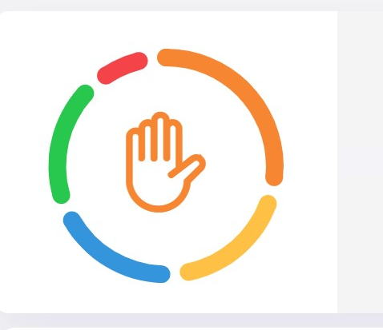
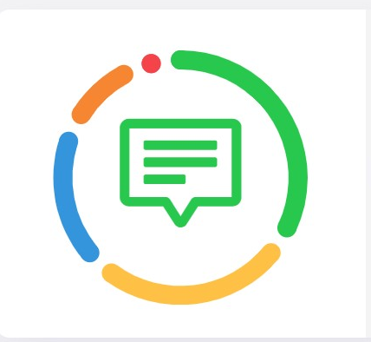
Everyone is Unique in the Way They Receive and Give Love
33% Quality Time
30% Acts of Service
20% Words of Affirmation
10% Receiving Gifts
7% Physical Touch
Parent
Child #1
Child #2
33% Physical Touch
20% Quality Time
20% Acts of Service
20% Words of Affirmation
7% Receiving Gifts
40% Words of Affirmation
30% Quality Time
20% Acts of Service
20% Physical Touch
0% Receiving Gifts
Amber Raymond & Lynn McLaughlin 2024
Notes:
Amber to share connections – Link to Love Language Survey is at the end of the presentaion

Slide 11
Step By Step as a Parent
Steps for emotionally heated moments:
In calm collected moments sit with your children and talk about a new family plan for heated moments. This lets them know that when you are taking space or insisting they take space, there is a purpose.
Walk away or send them away to process and release emotions.
Find a grounding technique that helps you come back to your logical brain. We can't think logically when we’re emotional. Some suggestions include:
8 count breathwork
walking outside
aroma therapy
calming music (solfeggio frequencies)
journaling
Amber Raymond & Lynn McLaughlin 2024
Notes:
Amber

Slide 12
Self reflection: Once we're grounded, we can reflect on what happened with a clear
mind and problem solve.
What are you feeling? (Misunderstood, scared, embarrassed, neglected...)
What are you thinking? (I should have said things differently … they don't understand … they must hate me.)
What is bothering you? (Is this reminding you of something in your past?)
What do you need? (A hug, to apologize, to rephrase...)
4. Come up with a solution. Given what you discovered in self-reflection, what do you
logically think needs to happen to resolve the issue?
5. Once everyone has processed their emotions/thoughts, come back together to talk
about what everyone's needs are and create a plan together. The important thing is
that everyone learns they are capable of processing and releasing their emotions on
their own and sometimes we need help with problem solving, no matter what our age
is. Once everyone knows how to self sooth, things will start calming down.
Amber Raymond & Lynn McLaughlin 2024

Slide 13
Notes:
Amber to explain each one more fully

Slide 14
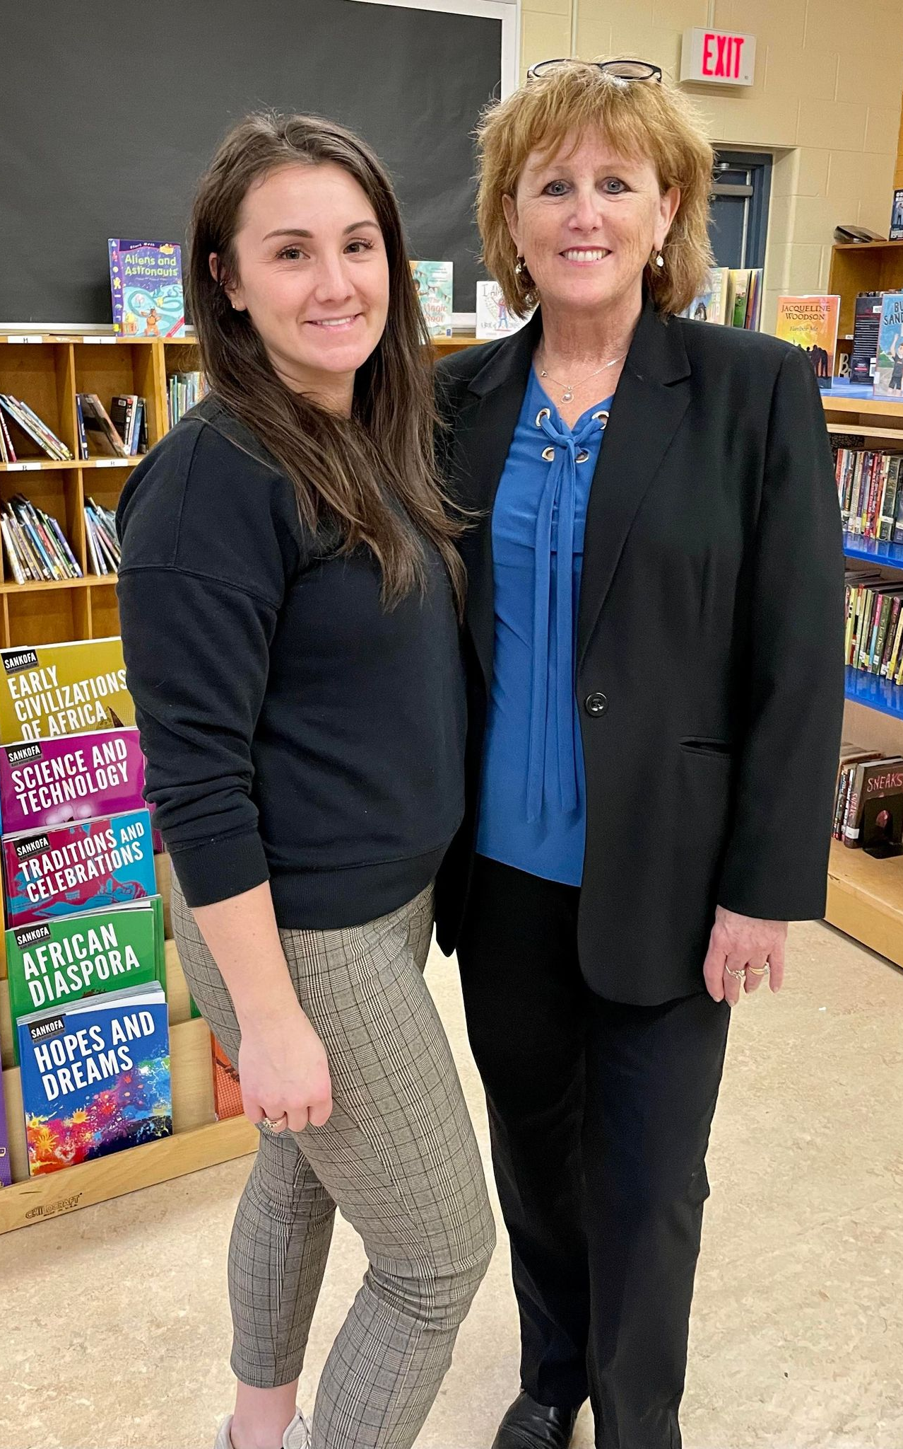
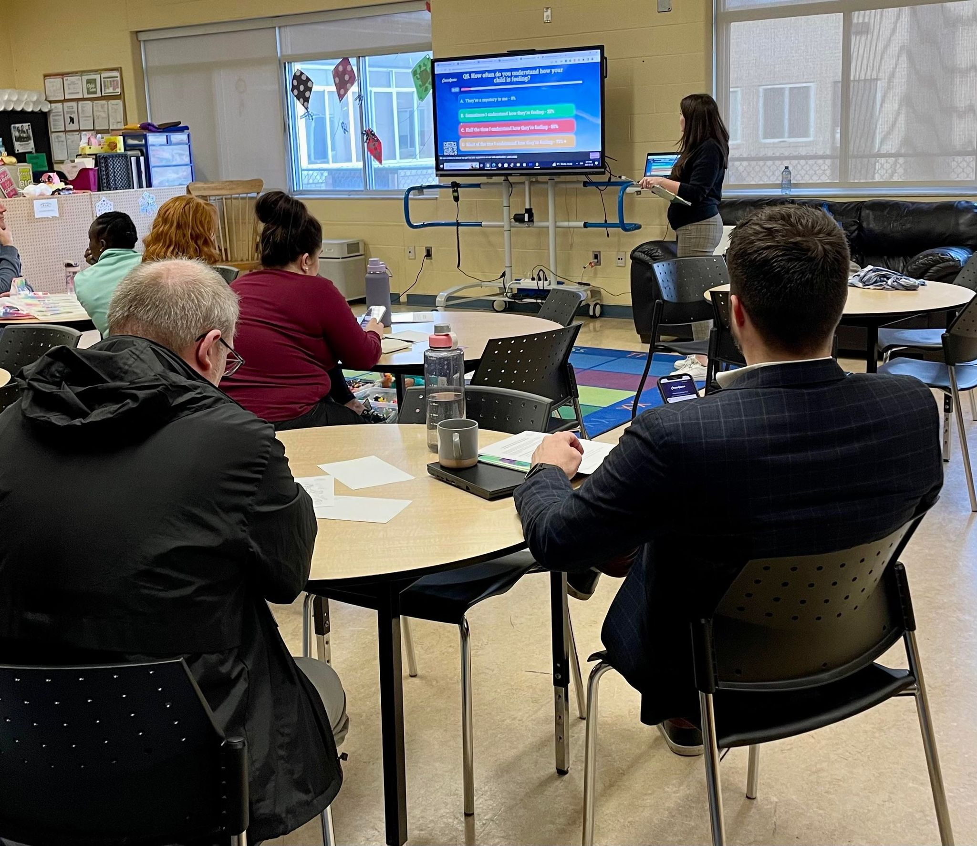
Interactive Community Presentations …
Virtual or In-Person
Email
lynn@lynnmclaughlin.com

Slide 15
Resources
The Power of Thought Resources
Messsmakers
Taking the Helm Podcast
Cosmic Kids Yoga
Emental Health Canada
The Love Language Quiz
LD@Home
Learning Disabilities Association of Ontario
Amber Raymond & Lynn McLaughlin 2024

Slide 16
Download your Free Guide. Watch for the pop-up at …
https://lynnmclaughlin.com
Amber Raymond & Lynn McLaughlin 2024

